Slide 1
Agenda
Quiz 8 review
Questions for Assignment 6
https://cs.gmu.edu/~winglam/classes/637/assigns/assign06.html
Assignment 6 is due next week. We will then release the optional take-home final. If you are concerned about your grades, I highly encourage you to spend time on the optional take-home final
Wrap up lecture on Chapters 8.1.4 & 8.1.5 Logic Coverage
Lecture on Chapter 9.1 & 9.5 Grammar-based Testing
15min break
Lecture on Ch 9.1.2 Mutation Testing
Pass back Quiz 8
Next week’s will be on Mutation Testing and Android Testing. Read Ch 9.1.2 and CodeDefenders before class
https://code-defenders.org
Everyone should bring a laptop for next week (Nov. 16th)

Slide 2
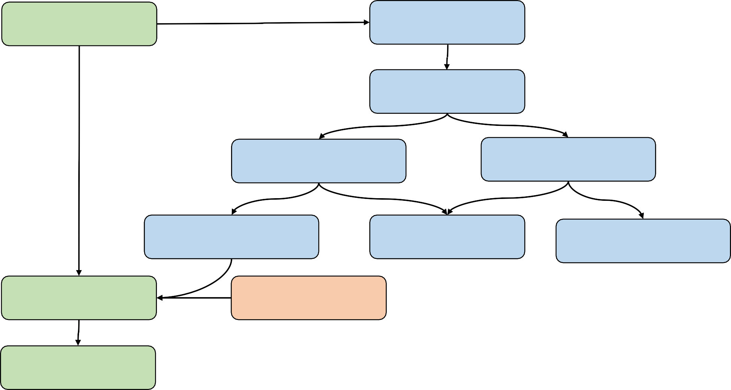
Coverage subsumption graph
Path Coverage
All-DU-Paths
All-Uses
All-P-Uses/ Some-C-Uses
All-P-Uses/ Some-C-Uses
All-P-Uses
All-Defs
All-C-Uses
Mutation Testing
Branch Coverage
Statement Coverage

Slide 3
Mutation Testing
Basic idea
Detailed Approach
Limitation and solutions
Do fewer
Do faster
Do smarter
State of the art tools

Slide 4
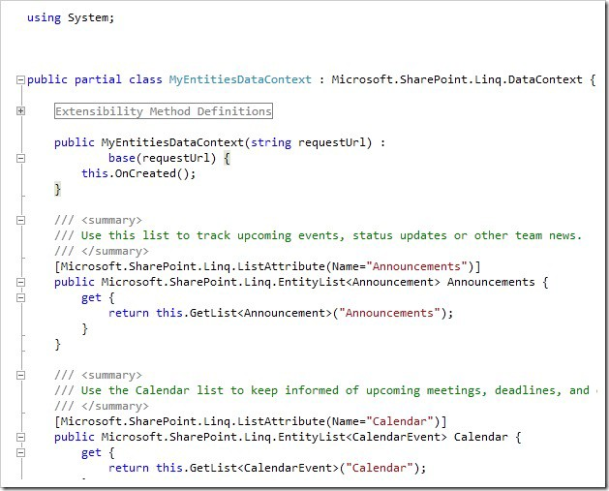



Who will test the tests?
Verify Quality
Verify Quality
T
Program
Tests
Code coverage
e.g., statement coverage, branch coverage, data-flow coverage (X)
Different ways to assess test quality?
Real bugs!!!
Test: sum(1,0)==1?
public int sum(int x, int y){ return x-y; //should be x+y
}

Slide 5









Real bugs for test effectiveness evaluation
More real bugs detected More effective test suite
However, real bugs are usually small in number, making it hard to
Evaluate test effectiveness comprehensively
Evaluate test effectiveness in detecting future bugs
Any other ways?
How about creating artificial bugs to simulate real bugs in test effectiveness evaluation

Slide 6
6
Genetic mutation injects changes to chromosomes of organisms
Mutation testing injects changes to statements of programs to generate artificial bugs
Capability to detect more real bugs
More artificial bugs detected
More effective tests

Slide 7
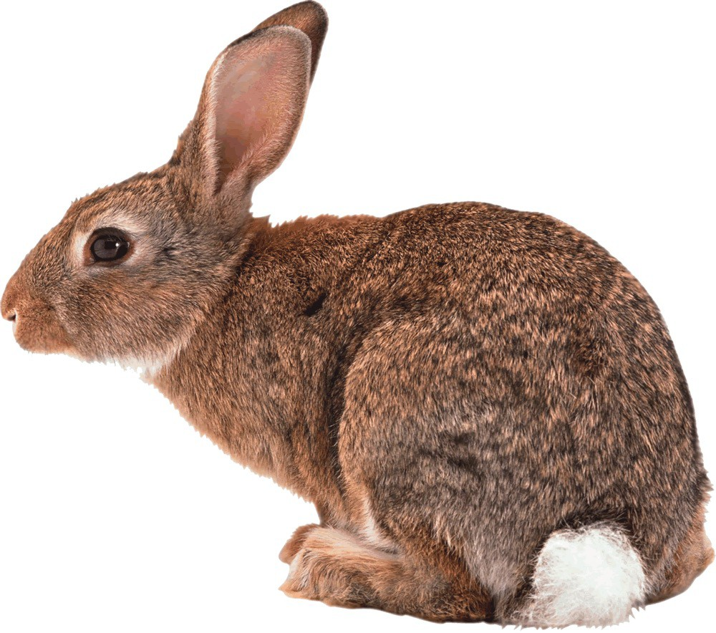
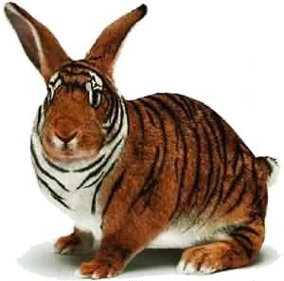


Mutation Testing
7
Step-1: Applies artificial changes based on mutation operators (aka mutators) to generate mutants
Original Program
Mutant
Mutation Operator

Slide 8
Mutation Testing
Step-1: Applies artificial changes based on mutation operators (aka mutators) to generate mutants
Mutating Apache Commons-Lang using example operators
if (mTimeZoneForced) { calendar.getTimeInMillis();
calendar = (Calendar) calendar.clone(); calendar.setTimeZone(mTimeZone);
}
Cond. Negation
if (!mTimeZoneForced) { calendar.getTimeInMillis();
M1
Invocation Deletion
if (mTimeZoneForced) { calendar.getTimeInMillis();
M2
calendar = (Calendar) calendar.clone();
calendar.setTimeZone(mTimeZone);
}
if (mTimeZoneForced) { calendar.getTimeInMillis();
M3
Invocation Deletion
calendar = (Calendar) calendar.clone();
calendar.setTimeZone(mTimeZone);
}
Original Program P
calendar = (Calendar) calendar.clone();
calendar.setTimeZone(mTimeZone);
}
8

Slide 9



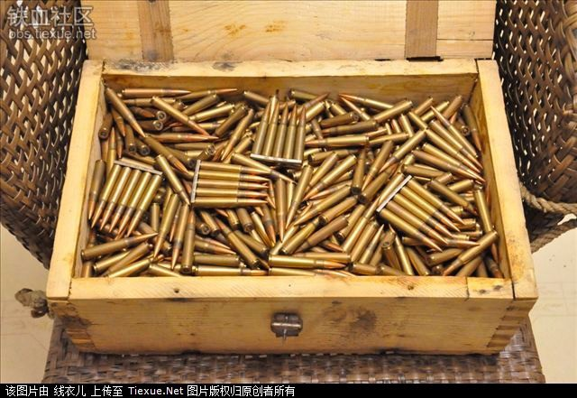
Mutation Testing
9
Step-2: Execute the test suite against each mutant
Tests
Test Execution
Mutant
All tests pass, the mutant survives
Any test fails (i.e., mutant’s output
!= original output), the mutant is killed
Test Suite

Slide 10



Mutation Testing
Step-2: Execute the test suite against each mutant
public StringBuffer format(Calendar calendar, StringBuffer buf) { if (mTimeZoneForced) {
calendar.getTimeInMillis();
calendar = (Calendar) calendar.clone(); calendar.setTimeZone(mTimeZone);
}
return applyRules(calendar, buf);
}
A mutant of Apache Common-Lang
If there is a real fault, the test suite may also miss it!
class Checker {
public int compareTo(Object other){ return 0;
+return 1;
}
}
A mutant of AspectJ

Slide 11





Mutation Testing
Step-3: Compute the mutation score (e.g., the ratio of killed mutants)
The higher the better
Kill 8 of 10 mutants
T1
Kill 4 of 10 mutants
T2

Slide 12
Summary of Mutation Testing
A fault-based methodology for evaluating tests [Hamlet1977, DeMillo+1978]
Step-1: Applies artificial changes based on mutation operators to generate mutants (each mutant with only one artificial bug)
Step-2: Runs the test suite against each mutant
If any test fails (i.e., mutant’s output != original output), the mutant is killed
If all tests pass, the mutant survives
Step-3: Computes the mutation score: the higher, the better

Slide 13




Does Mutation Testing work?
Following example is 100% for all control-flow and data-flow coverage
How about mutation testing?
public int sum(int x, int y) { return x-y; // should be x+y
}
Test: sum(1,0)==1?
public int sum(int x, int y) { return x*y;
}
Mutation can be stronger than control/data-flow coverage!
public int sum(int x, int y) { return x-0;
}
…
mutants
13

Slide 14

Does Mutation Testing work?
“Mutation testing is more
powerful than statement or branch coverage.”
Walsh, PhD thesis, State University of NY at Binghampton, 1985
“Mutation testing is
superior to data-flow coverage criteria.”
Frankl, Weiss, Hu, Journal of Systems and Software, 1997
“Generated mutants are similar to real faults.”
Andrews, Briand, Labiche, ICSE 2005
“Mutants can substitute
real faults in software testing experimentation.”
Just, Jalali, Inozemtseva, Ernst, Holmes, and Fraser, FSE 2014
14

Slide 15









Does Mutation Testing work?
"... While we also used Clover for basic code coverage, as we got our PIT mutation coverage up into the 90s I stopped paying much attention to Clover"
"... This gave us extreme confidence in our tests ... The effects of that confidence were outstanding."
15

Slide 16
This class
Mutation Testing
Basic idea
Detailed Approach
Limitation and solutions
Do fewer
Do faster
Do smarter
State of the art tools

Slide 17
Mutation Operators
Mutation operators are language dependent
Fortran: a total of 22 operators were proposed
Java: around 40 operators were proposed
C: a total of 108 operators were proposed

Slide 18
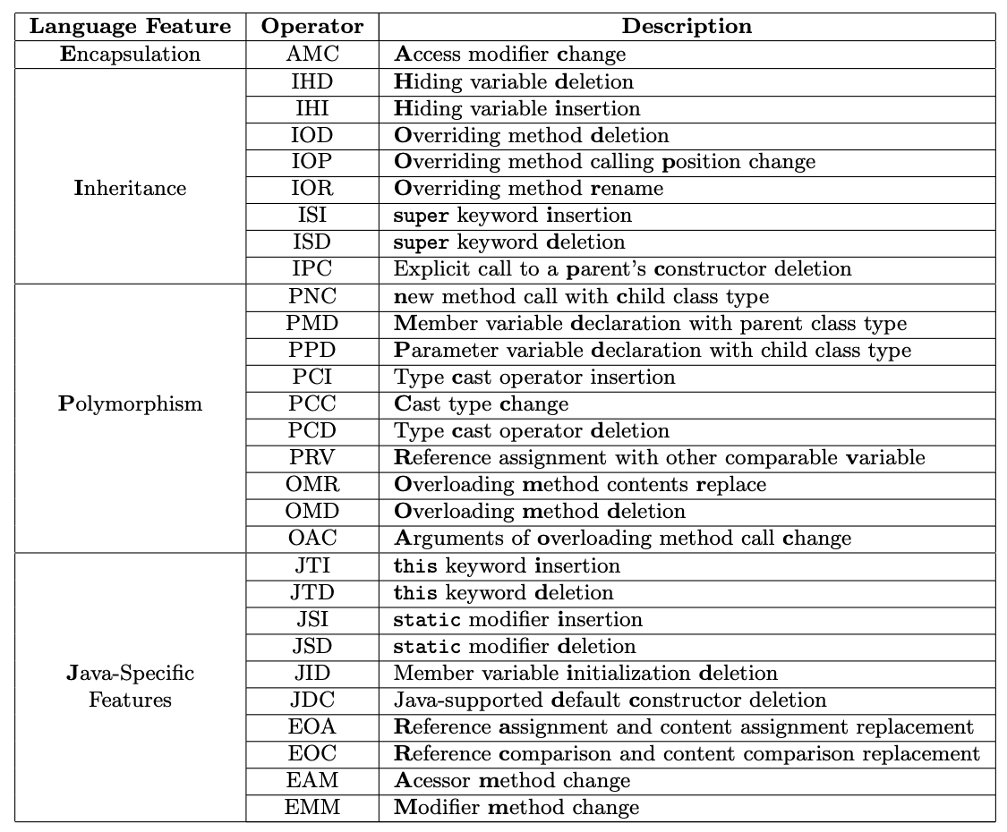
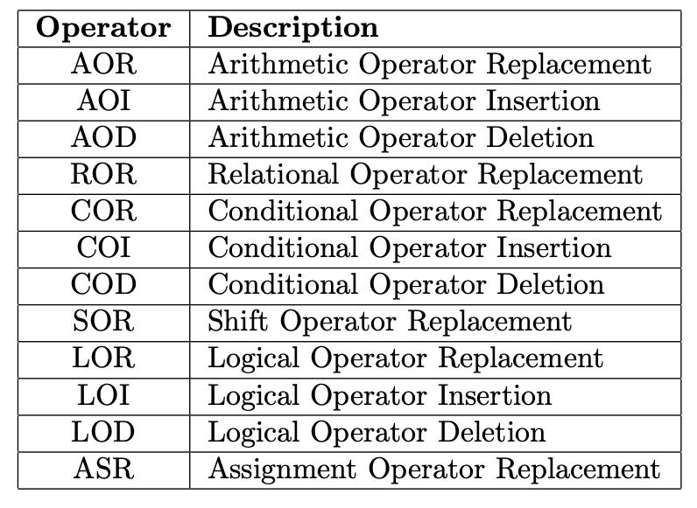
Java Mutation Operators (the MuJava tool)

Slide 19
ABS - Absolute Value Insertion
int gcd(int x, int y) { int tmp; while(y != 0) {
tmp = x % y; x = y;
y = tmp;
}
return x;
}
int gcd(int x, int y) { int tmp; while(y != 0) {
tmp = x % y; x = abs(y);
y = tmp;
}
return x;
}
P
M

Slide 20
ABS - Absolute Value Insertion
int gcd(int x, int y) { int tmp; while(y != 0) {
tmp = x % y; x = y;
y = tmp;
}
return x;
}
int gcd(int x, int y) { int tmp; while(y != 0) {
tmp = x % y; x = y;
y = tmp;
}
return abs(x);
}
P
M

Slide 21

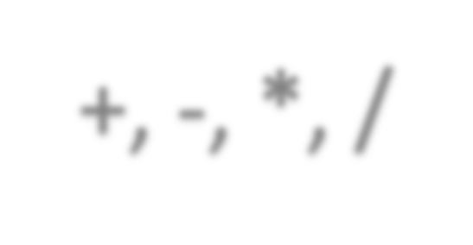



AOR - Arithmetic Operator Replacement
int gcd(int x, int y) { int tmp; while(y != 0) {
tmp = x
%
y;
+, -, *, /
x = y;
y = tmp;
}
return x;
}
P

Slide 22

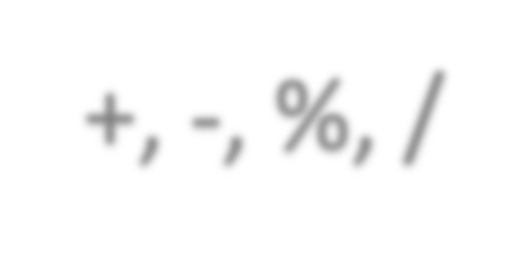


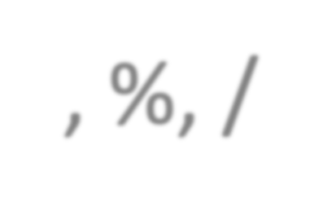
AOR - Arithmetic Operator Replacement
int gcd(int x, int y) { int tmp; while(y != 0) {
+, -, %, /
tmp = x
*
y;
x = y;
y = tmp;
}
return x;
}
P

Slide 23

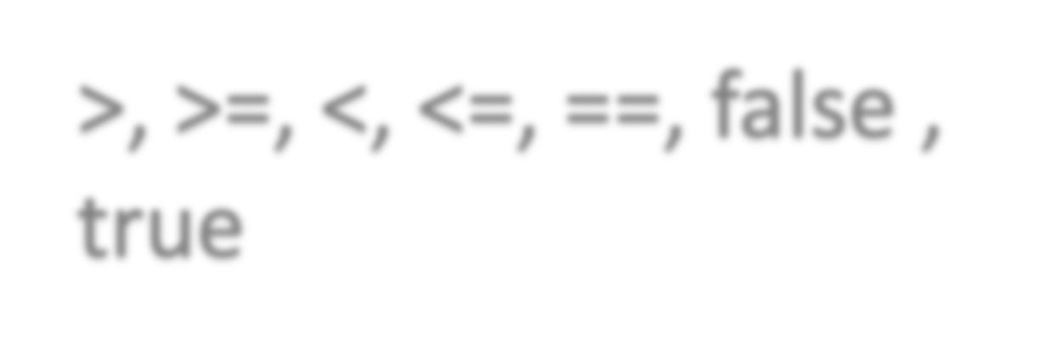
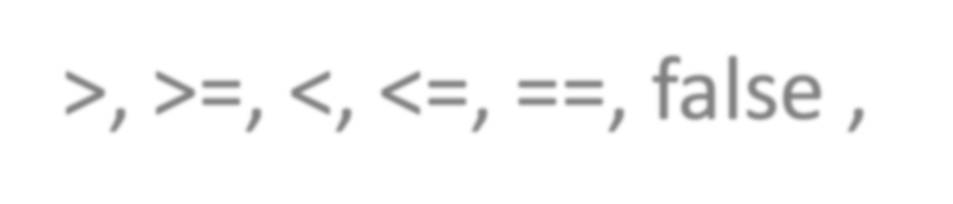

ROR - Relational Operator Replacement
int gcd(int x, int y) { int tmp;
while(y 0) {
>, >=, <, <=, ==, false ,
true
!=
tmp = x % y; x = y;
y = tmp;
}
return x;
}
P

Slide 24
COR - Conditional Operator Replacement
if(a || b) if(false) if(true) if(a)
if(b)
if(a && b)

Slide 25
SOR - Shift Operator Replacement
x = m<<a x = m>>>a x = m
x = m>>a

Slide 26
LOR - Logical Operator Replacement
x = m&n
x = m|n x = m^n x = m
x = n

Slide 27
UOI - Unary Operator Insertion
int gcd(int x, int y) { int tmp;
while(y != 0) {
x = y;
y = tmp;
}
return x;
}
tmp = x % (-y); tmp = x % (+y); tmp = x % (--y); tmp = x % (++y);
...
tmp = x % y;
P
mutants

Slide 28
SVR - Scalar Variable Replacement
int gcd(int x, int y) { int tmp; while(y != 0) {
x = y;
y = tmp;
}
return x;
}
tmp = x % x tmp = y % y x = x % y
y = y % x
tmp = tmp % y tmp
= x % tmp
...
tmp = x % y;
P
mutants

Slide 29
Types of Mutants
Killed (distinguished) mutants
Live mutants
Equivalent mutants
Non-equivalent mutants

Slide 30
Types of Mutants: definitions
A mutant M of program P is considered killed (or distinguished) by a test t in test suite T, iff:
P(t)!=M(t)
P(t) and M(t) denote, respectively, the test outputs of P and M when executed on test t.
A mutant M is considered to be equivalent mutant, iff
P(t)=M(t) for any t

Slide 31
Equivalent Mutant: example (1)
read a, b a=b x=a+b print x
read a, b a=b x=a+a print x
Scalar Variable Replacement
P
M

Slide 32
Equivalent Mutant: example (2)
read x
if (x>0)
x=x+1; else
x=x-1;
return x;
read x if (x>0)
x=abs(x)+1; else
x=x-1; return x;
Absolute Value Insertion
P
M

Slide 33
Kill a Mutant
Reachability
Execute the mutated statement
Necessity
Make a program internal state change
Sufficiency
Propagate the change to output

Slide 34
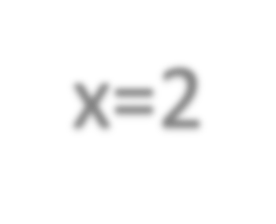

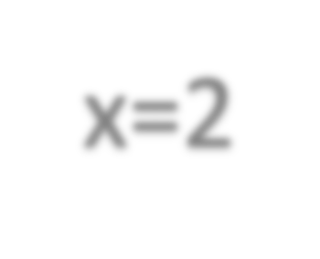


Kill a Mutant: example
read x
if (x>0)
x=x+1; if(x<4)
x=1;
return x;
read x
if (x>0)
x=1+1;
if(x<4) x=1;
return x;
x=2
x=2
Value Replacement
tests | reachability | necessity | sufficiency | killed?
0 |  |  |  | N (1=1)
1 |  |  |  | N (1=1)

Slide 35

Kill a Mutant: example
read x
if (x>0)
x=x+1; if(x<4)
x=1;
return x;
read x
if (x>0)
x=1+1;
if(x<4) x=1;
return x;
x=3
x=3
Value Replacement
tests
reachability
necessity
sufficiency
killed?
0
N (1=1)
1
N (1=1)
2
N (1=1)
3
Y (4!=1)

Slide 36
Agenda
Quiz 8 review
Questions for Assignment 6
https://cs.gmu.edu/~winglam/classes/637/assigns/assign06.html
Assignment 6 is due next week. We will then release the optional take-home final. If you are concerned about your grades, I highly encourage you to spend time on the optional take-home final
Wrap up lecture on Chapters 8.1.4 & 8.1.5 Logic Coverage
Lecture on Chapter 9.1 & 9.5 Grammar-based Testing
15min break
Lecture on Ch 9.1.2 Mutation Testing
Pass back Quiz 8
Next week’s will be on Mutation Testing and Android Testing. Read Ch 9.1.2 and CodeDefenders before class
https://code-defenders.org
Everyone should bring a laptop for next week (Nov. 16th)

